Slide 1
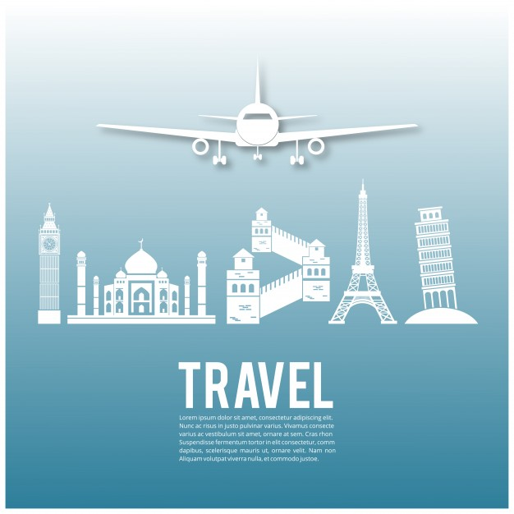
Welcome to our Flight Reservation system .

Slide 2
Our Team Members
Alhasan Gamal mahmoud Farhat .
Belal Elsayed mohamed Ali Elwikel .
Aya Sobhy AbdElhamed Hussain .
Aya AbdElmonaim Anwer Kansouh .
Enas Gamal Ali Ahmed .

Slide 3
Introduction
This program is a way to booking planes , helps you and gives you several choice to choose the best trip for you .

Slide 4
Aim to
This program aims to help user to make his job easier as entering data , saving data , Calling data and giving the traveler amount of selection

Slide 5
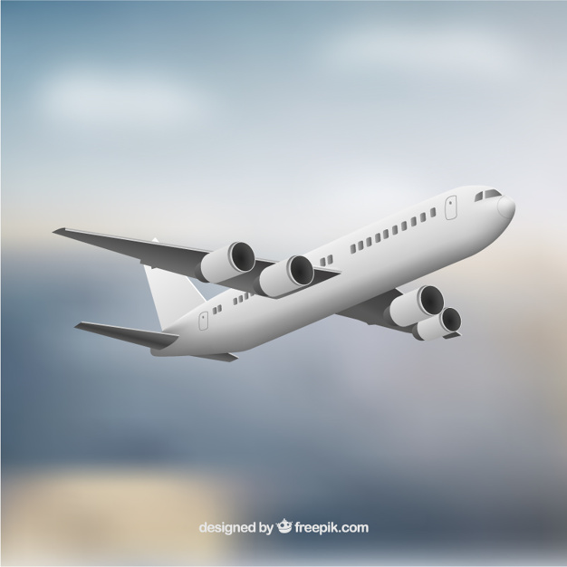
At our first form

Slide 6
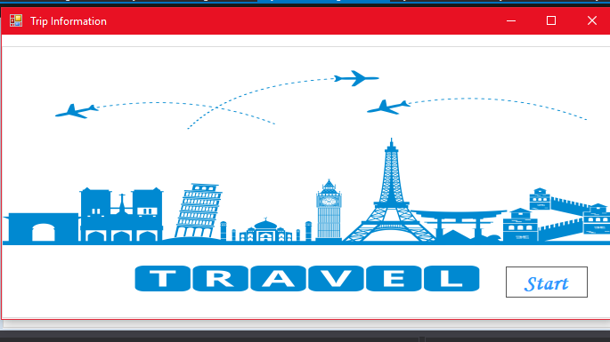
Groupbox
This groupbox helps you to enter the program .

Slide 7
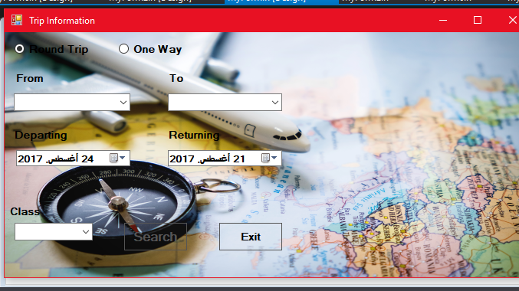
Design of first form

Slide 8
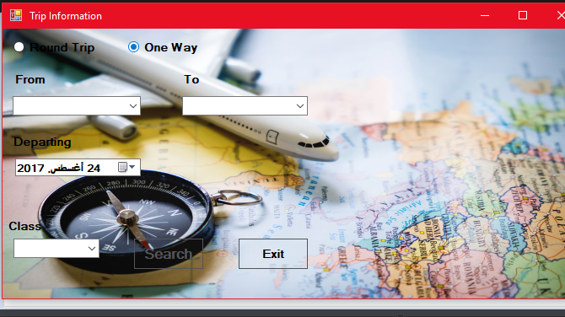
RadioButton
This Radiobutton Helps user to select the trip kind.

Slide 9
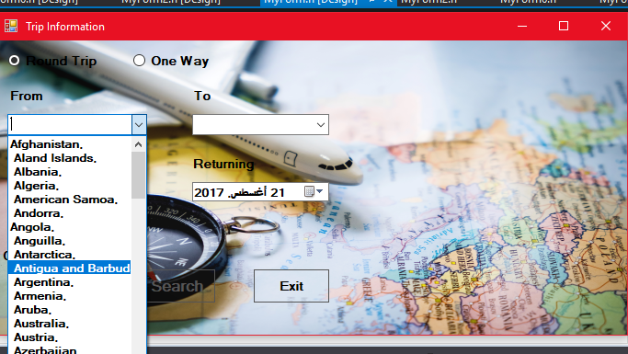
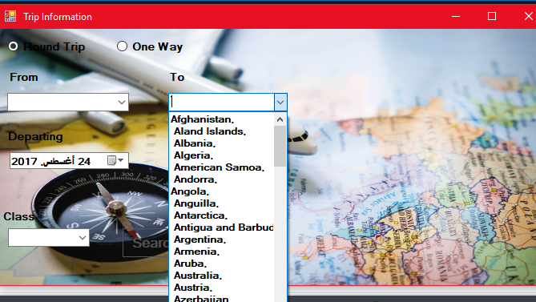
Comboboxs
This ComboB0x Button helps you to select the country you want to travel to and from .

Slide 10
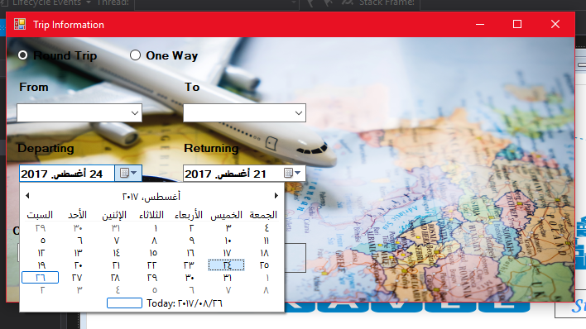
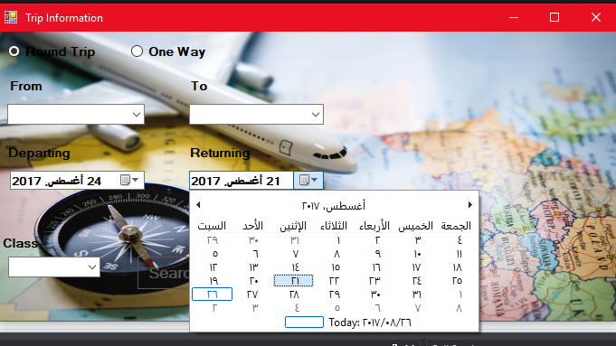
Data Time picker
This Data Time Picker Helps user to select the trip time to leave and return.

Slide 11
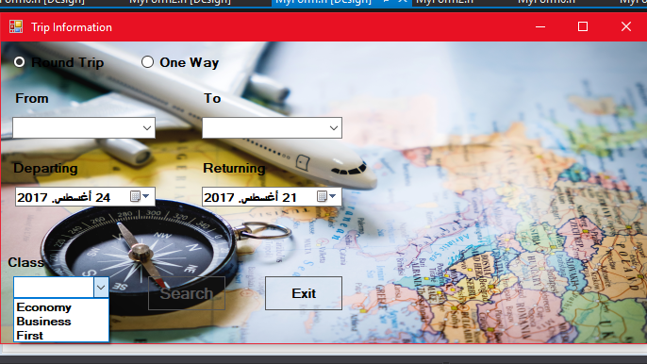
Class ComboBox
This comboBox Helps user to select the trip class and the price for the traveller . ticket.

Slide 12
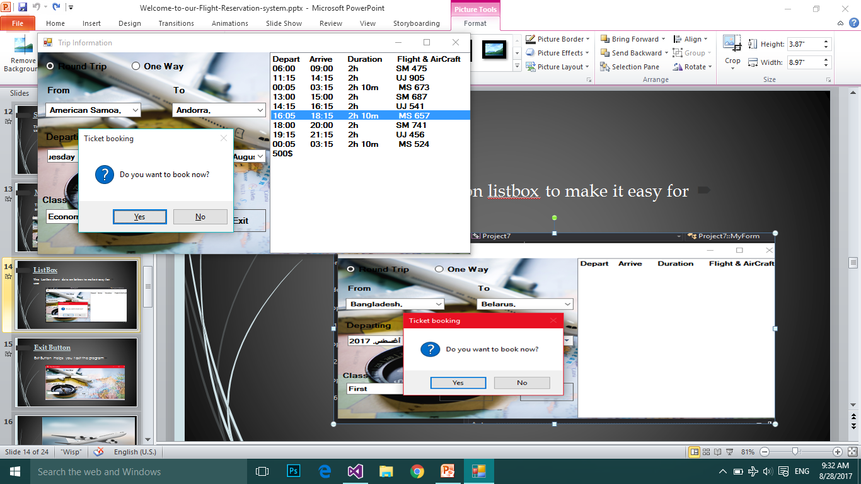
Search Button
This Search button Helps user to search on file using date and give us data on listbox .

Slide 13
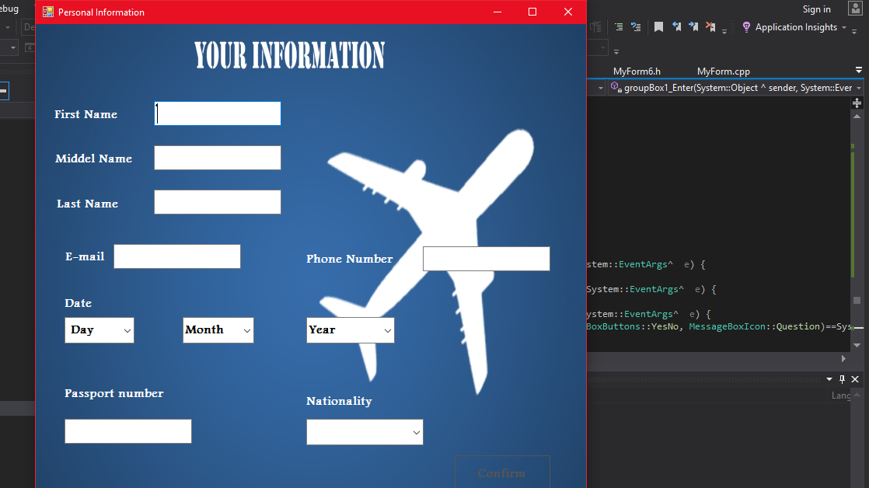
Massage Box
This massage Box helps user when he filling data and make him choose the better order for him .

Slide 14
ListBox
This ListBox show data on listbox to make it easy for user .

Slide 15
Exit Button
Helps you t exit the program Exit Button

Slide 16
Second form

Slide 17
Information form
On this form user take every information about the traveler.

Slide 18
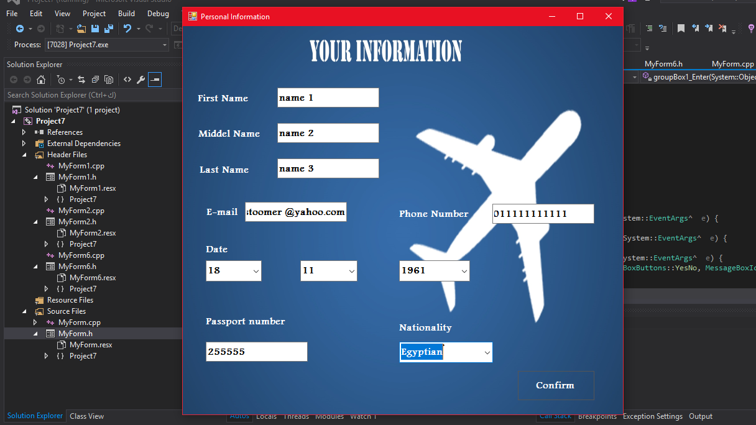
Confirm Button
This button use to confirm data and to save data of traveler in file

Slide 19
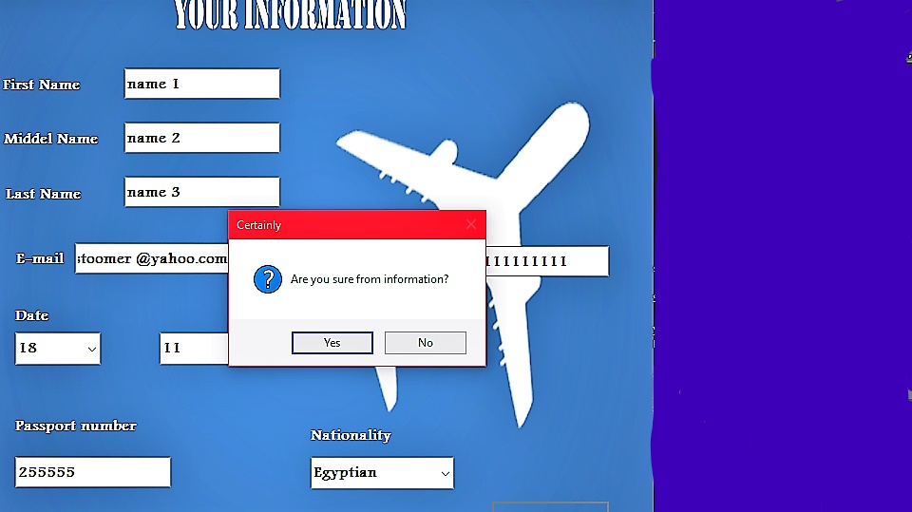

Slide 20
Third form

Slide 21
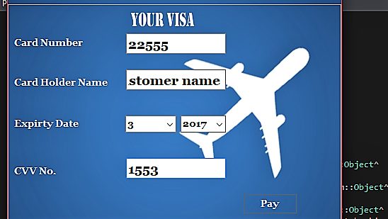
Visa form
This form helps the user in taking money from the traveller .

Slide 22
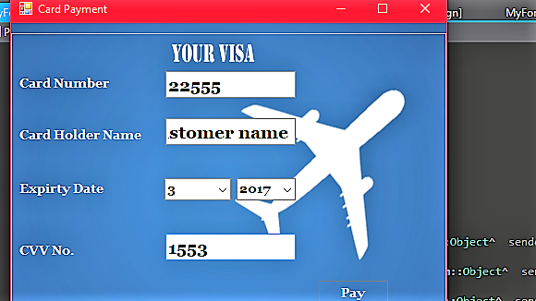
Pay Button
This button helps you to finish your booking

Slide 23
The last form

Slide 24
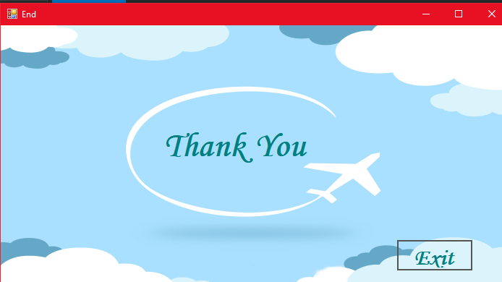
Exit Button
This button helps you to end the program when you finish

